Slide 1
Mobile Application Development
User interface Adapters

Slide 2
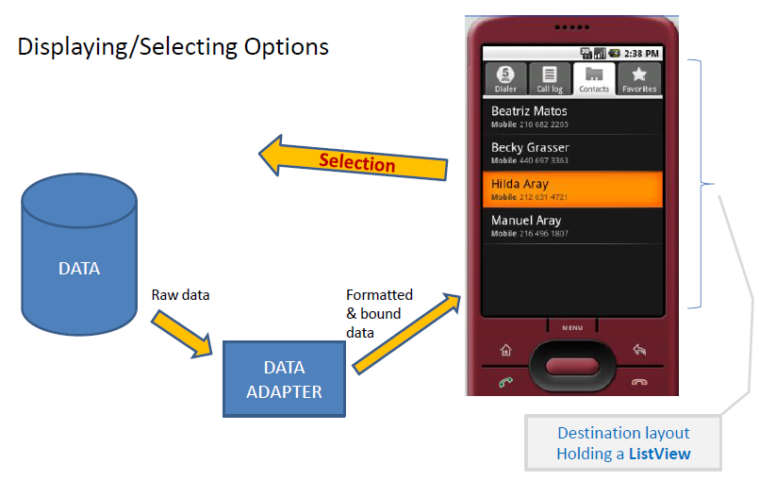
What is an adapter object
An Adapter object acts as a bridge between an AdapterView and the underlying data for that view.
It provides access to the data items.
It is also responsible for making a View for each item in the data set.

Slide 3
Types of Data Adapters
Types of data adapter include:
  ArrayAdapter
  ListAdapter
  CursorAdapter

Slide 4
What is an AdapterView
• An AdapterView is a viewGroup that access data through Adapter
object
Commonly used AdapterViews are:
  ListView,
  GridView,
  Spinner
  Photo Gallery

Slide 5
AdapterView Responsibilities
Two main responsibilities of AdapterView
Filling the layout with data received through the help of an Adapter object
Handling user selections - when a user selects an item, the adapterView performs some action

Slide 6
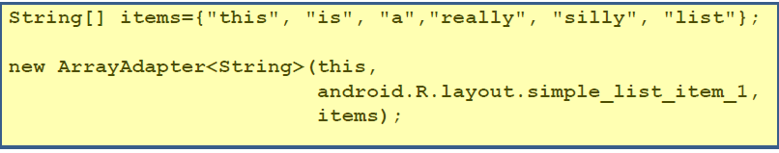
ArrayAdapter
ArrayAdapter is used to wrap a Java array or java.util.List instance,
It takes the following parameters
1. Context: an instance of the current activity
2. Layout of organizing the items: e.g. android.R.layout.simple_list_item_1 (as shown above)
3. The actual data source: such as array or list of items to show

Slide 7
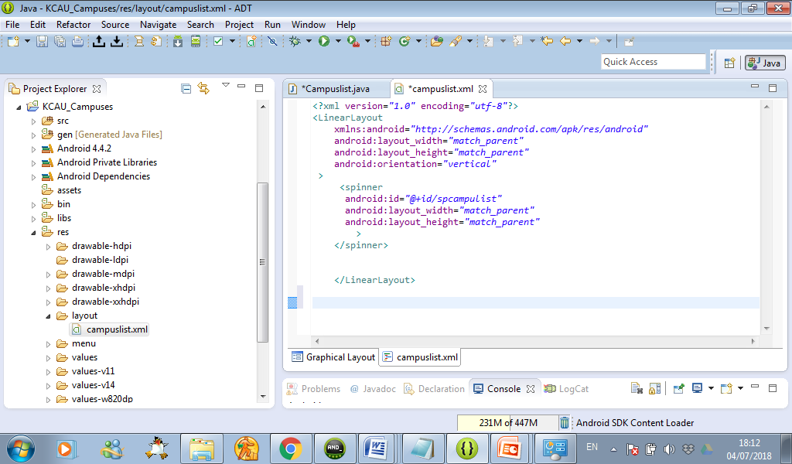
Using adapter object
Step one: Define a view object on an xml file

Slide 8
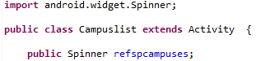
Using adapter object
Step Two: Declare Reference variable within an activity class that is in java file
Example

Slide 9
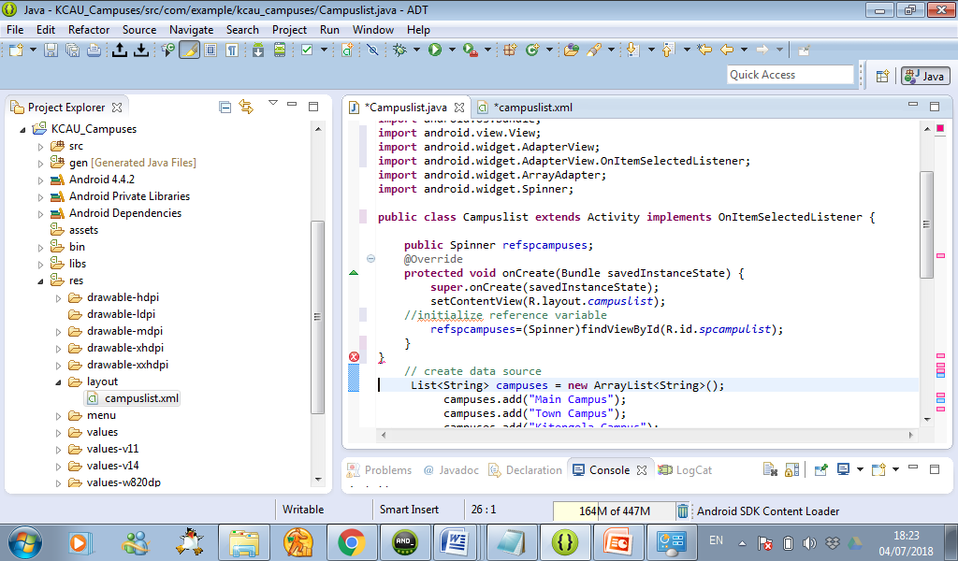
Using adapter object
Step Three: initialize reference variables with ID of adapter view
This is done by calling findViewById() method within oncreate () method
Example

Slide 10
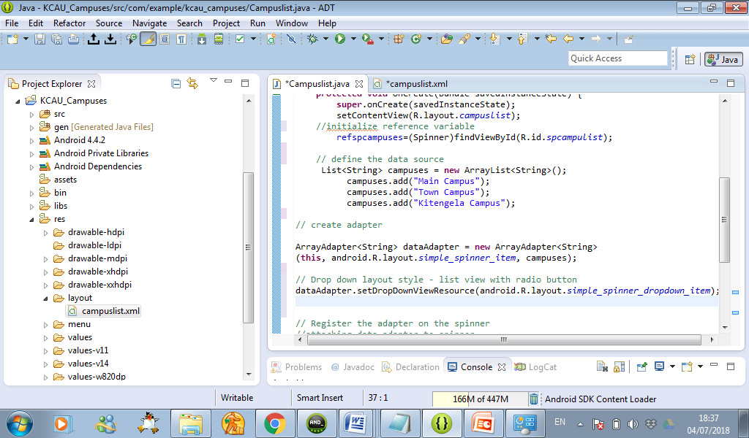
Using adapter object
Step Four: Define the source of data with in oncreate method
For example,
An arraylist can be declared and initialized with data items as follows:

Slide 11
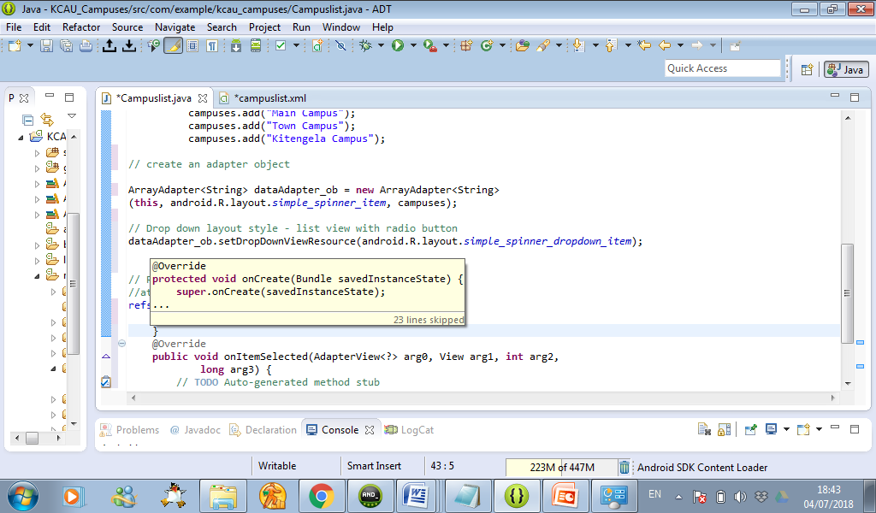
Using adapter object
Step Five: Define an Adapter object within onCreate() method
For example,
The following code creates an adapater object called dataAdapter_ob
and wraps the arraylist called campuses

Slide 12
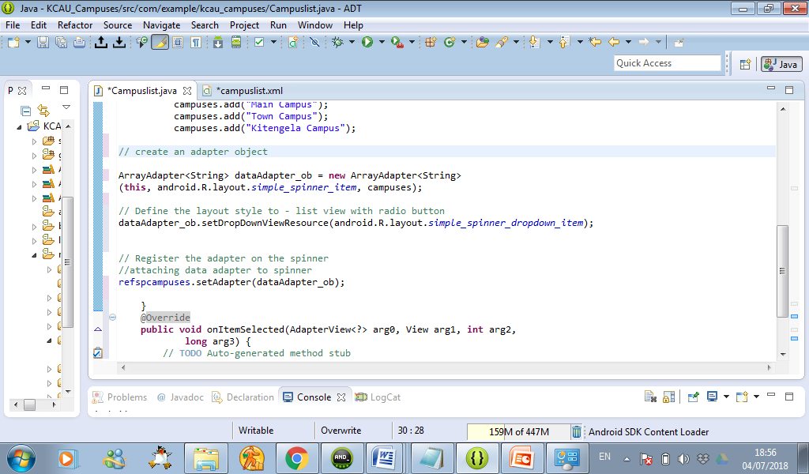
Using adapter object
Step Six: Define the layout style for organizing items on AdapterView
Example

Slide 13
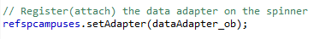
Using adapter object
Step seven: Register(attach) the data adapter object on the adapter view
Example

Slide 14
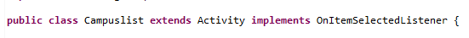
Using adapter object
Step seven: Implement OnItemSelected listener for detecting items selected by the user.
Example

Slide 15
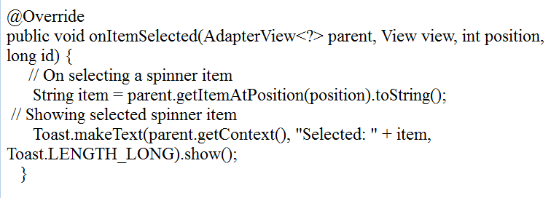
Using adapter object
Step eight: Define the event handlers for that will be triggered by the onItem selected Listener
Example:
The following code defines an event handler that will identify
and show the selected item

Slide 16
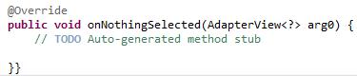
Using adapter object
Step eight: Define the event handler for that will be triggered if nothing is selected

Slide 17

